Slide 1

Introduction to Data Analysis & Visualization with R
Brian Zelip
Emerging Technologies Librarian
bzelip@hshsl.umaryland.edu

Slide 2
Agenda of Workshop
R basics
Installation
Practice
Plotting data
Statistical analysis
Scope of Workshop
Demonstration over explanation of statistical concepts

Slide 3
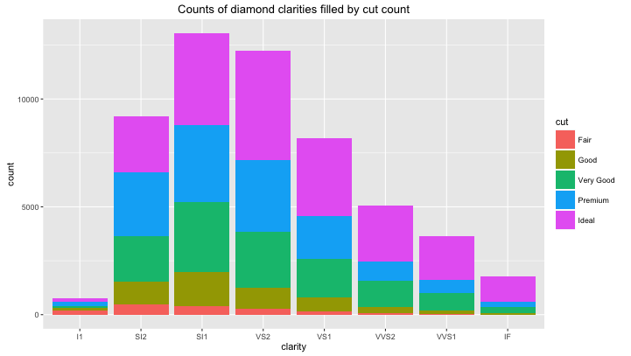
Examples of Workshop Output

Slide 4
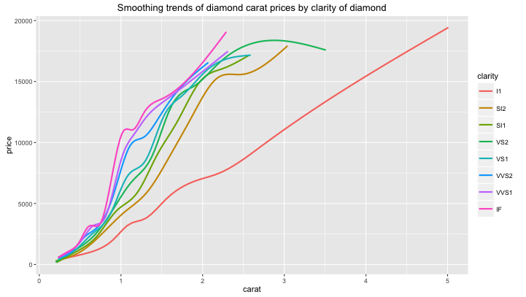
Examples of Workshop Output

Slide 5
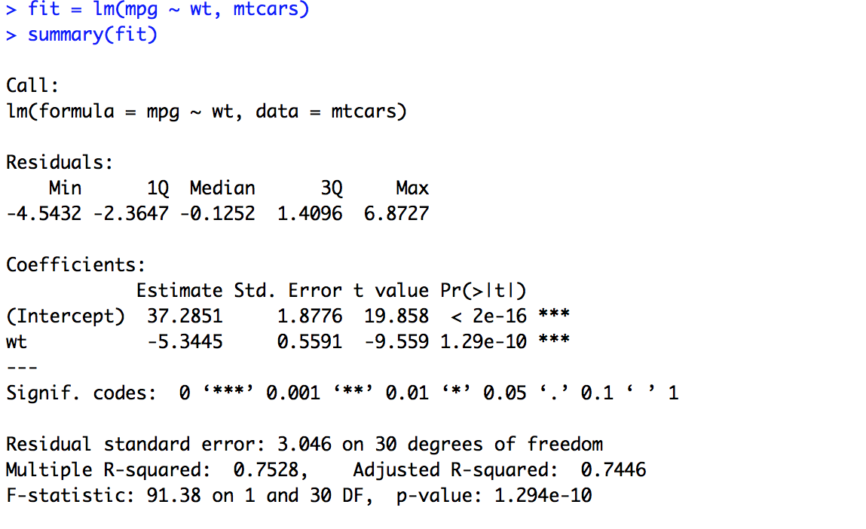
Examples of Workshop Output

Slide 6
About R
https://www.r-project.org/
Free and open source software
Runs on Windows, OSX, GNU/Linux, FreeBSD, and more
R is a programming language and environment
Default install provides “base R” suite of packages, or tools
Install more packages via CRAN
CRAN = Comprehensive R Archive Network
https://cran.r-project.org/
The main source for downloading for R and most packages
Each package comes with documentation
Very active global community of users and developers (so help and guidance can usually be found quickly online)

Slide 7
R’s Package Ecosystem
base R
3rd party
CRAN packages
3rd party packages not yet in CRAN

Slide 8
RStudio
https://www.rstudio.com/
Free and open source software
Combines the power of the command line with the usability of a graphical user interface
Provides the same experience across operating systems (which the R application and other GUIs do not)
Requires prior R installation

Slide 9
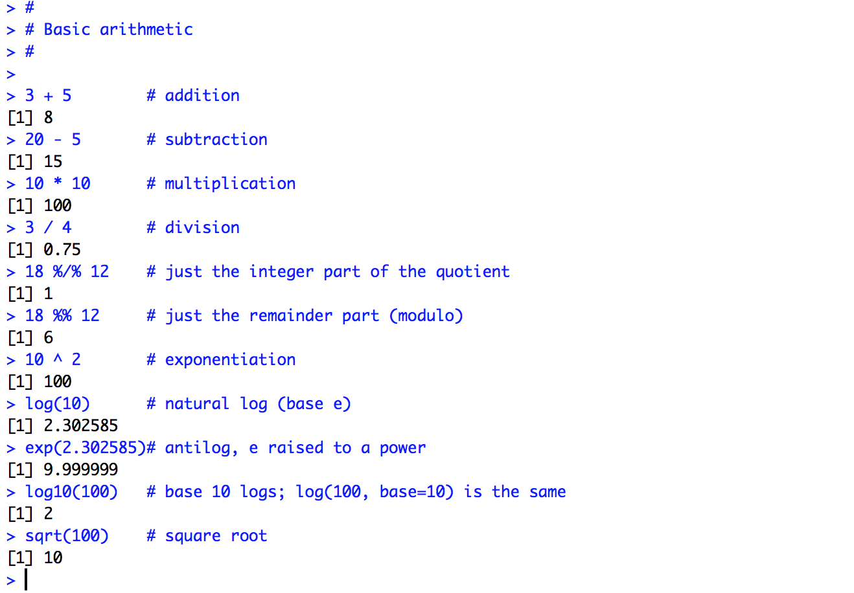
Brief Look at R Syntax for Basic Calculation

Slide 10
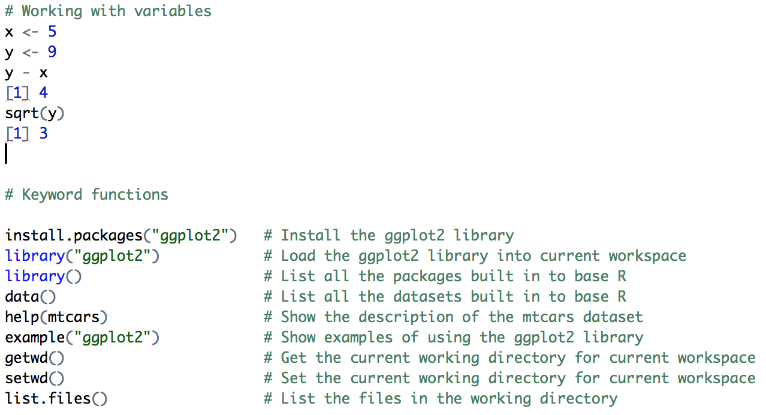
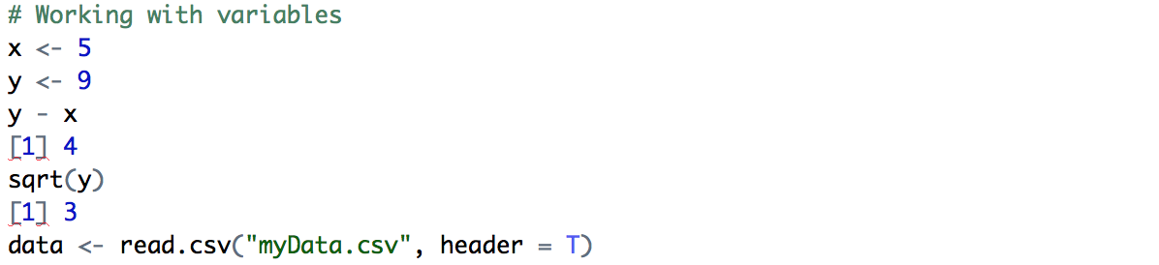
Brief Look at More Useful R Syntax

Slide 11
INSTALLATION
R, https://cran.r-project.org/
RStudio, https://www.rstudio.com/

Slide 12
HANDS-ON DEMO

Slide 13
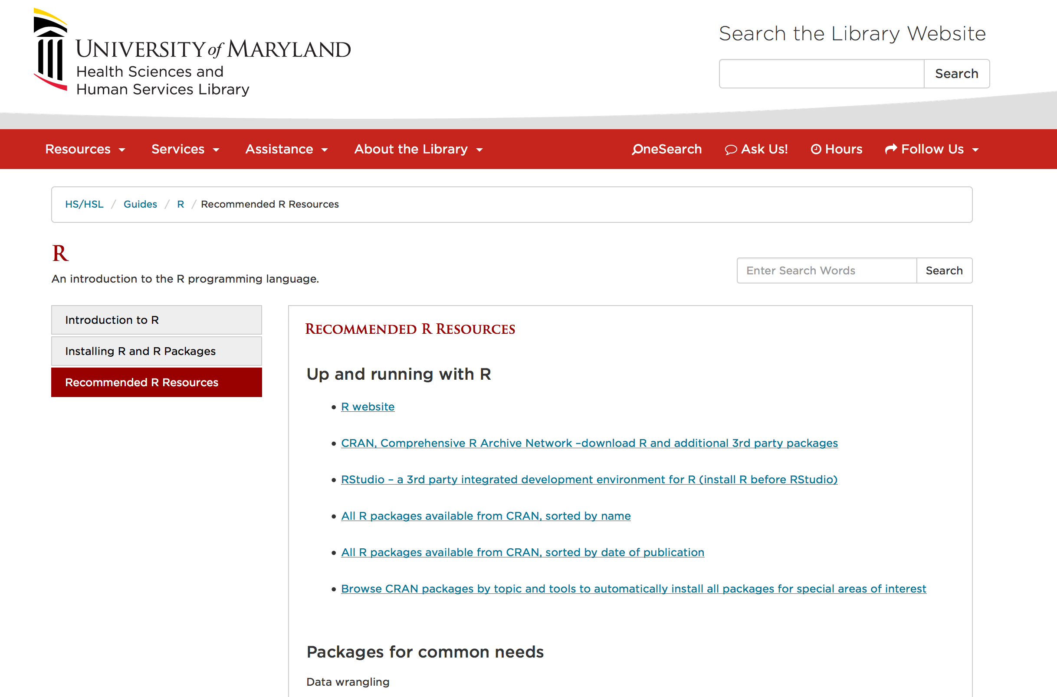
Library Guide on R
http://guides.hshsl.umaryland.edu/R

